Slide 1
PROJECT TITLE
“ Data Analysis Based On Online Retails Using Power BI ”
Good Evening, CEO and CMO. Thank you for taking the time to review the findings from recent data analysis. Today, I will walk you through the insights we have uncovered, specifically addressing the four key question you posed. I’ll also cover the data preparation process to ensure the accuracy and reliability of our result.
C. RAMANATHAN
Date: 27-08-2024

Slide 2
DATA PREPARATION OVERVIEW
To begin with, I want to outline the steps we took to prepare the data for analysis. Our initial data load involved consolidating multiple sources to ensure we had a comprehensive dataset. We then performed a thorough clean-up to address any inconsistencies or errors. This included:
Removing Duplicates: We identified and eliminated duplicate entries to ensure each data point was unique.
Handling Missing Values: We filled in missing values using appropriate methods based on the data type and context.
Data Validation: We cross-checked data entries against known benchmarks to ensure accuracy.
With the data cleaned and validated, we proceeded to the analysis, which was guided by the four specific questions you asked.

Slide 3
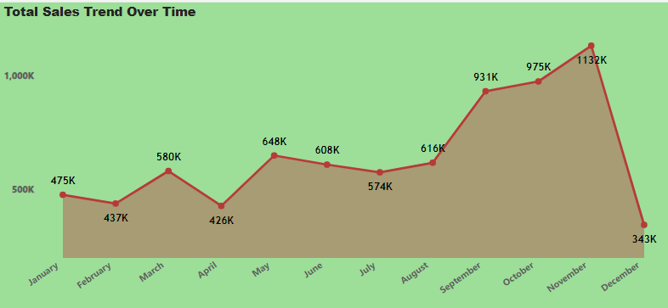
QUESTION:1
The CEO of the retail store is interested to view the time series of the revenue data for the year 2011 only. He would like to view granular data by looking into revenue for each month. The CEO is interested in viewing the seasonal trends and wants to dig deeper into why these trends occur. This analysis will be helpful for the CEO to forecast for the next year.

Slide 4
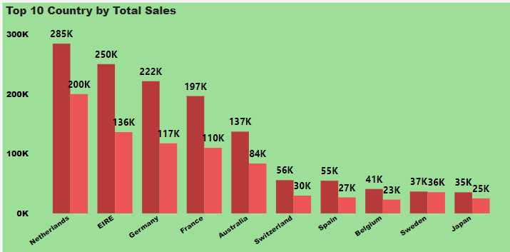
QUESTION:2
The CMO is interested in viewing the top 10 countries which are generating the highest revenue. Additionally, the CMO is also interested in viewing the quantity sold along with the revenue generated. The CMO does not want to have the United Kingdom in this visual.

Slide 5
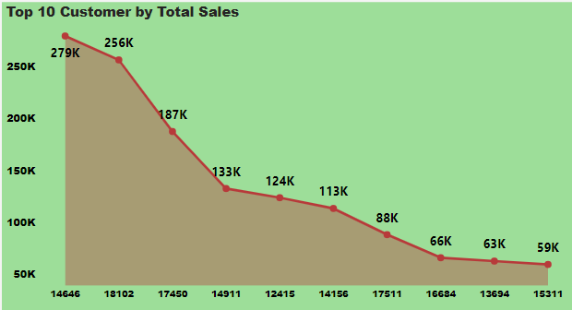
QUESTION:3
The CMO of the online retail store wants to view the information on the top 10 customers by revenue. He is interested in a visual that shows the greatest revenue generating customer at the start and gradually declines to the lower revenue generating customers. The CMO wants to target the higher revenue generating customers and ensure that they remain satisfied with their products.

Slide 6
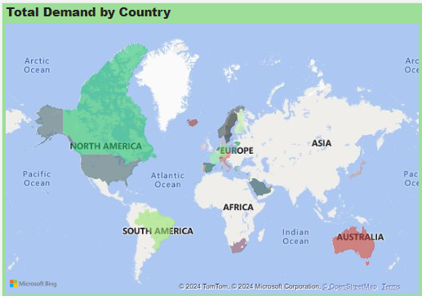
QUESTION:4
The CEO is looking to gain insights on the demand for their products. He wants to look at all countries and see which regions have the greatest demand for their products. Once the CEO gets an idea of the regions that have high demand, he will initiate an expansion strategy which will allow the company to target these areas and generate more business from these regions. He wants to view the entire data on a single view without the need to scroll or hover over the data points to identify the demand. There is no need to show data for the United Kingdom as the CEO is more interested in viewing the countries that have expansion opportunities.

Slide 7
KEY LEARNINGS
TECHNICAL SKILLS
Data Cleaning and Manipulation: Gained proficiency in using Power Query for cleaning and preprocessing datasets, handling missing values, Duplicate Values.
Data Visualization: Enhanced ability to create insightful visualizations using Data Visualization Power BI. Created dashboards and plots that effectively communicated trends and patterns in the data.

Slide 8
SUMMARY
To summarize, our analysis has provided valuable insights into Total sales Trend over Time, Top 10 Country by Total Sales, Top 10 Customer by Total Sales, Total Demands by Country. Moving forward, we recommend, which are designed to leverage these insights and drive growth.
Thank you for your attention. I’m happy to answer any questions or discuss any aspects of the analysis in more detail.

Slide 9


